Slide 1
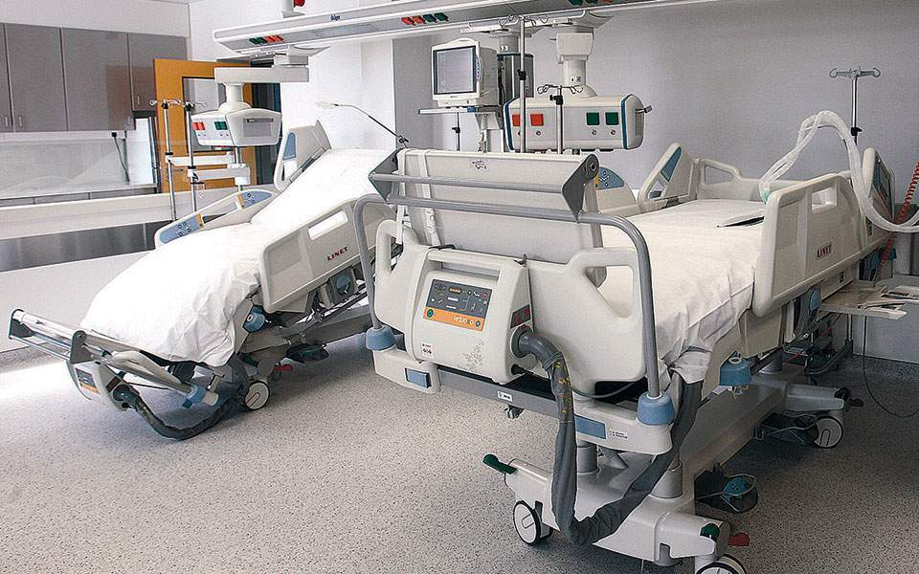
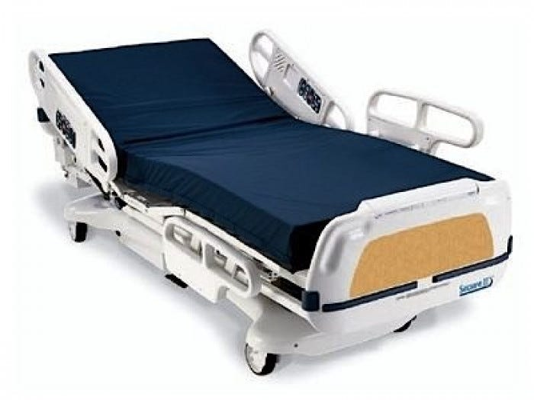


Using ArcGIS and Python to Provide Real-Time Location Awareness during COVID-19
Ed Conrad, M.S. Geography

Slide 2
Hospital Bed Availability
Statewide for non-COVID-19 & COVID-19 patients
Intensive Care Unit (ICU)
Medical / Surgical (Med/Surg)

Slide 3


Dept. of Health Requirements
Dynamic and static
Daily summaries
Available at anytime

Slide 4
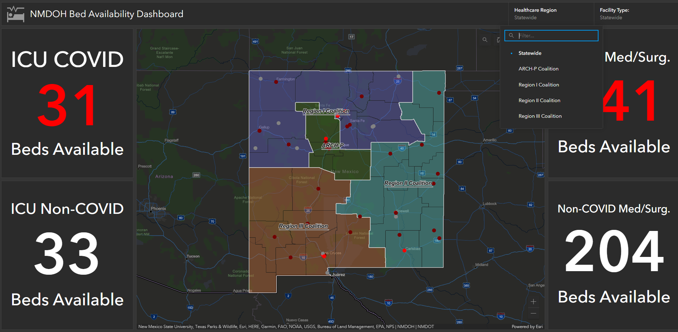
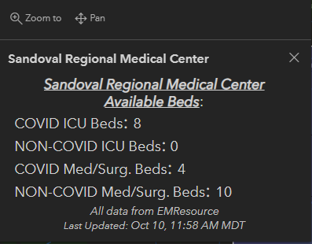
Deliverable (1/3)

Slide 5
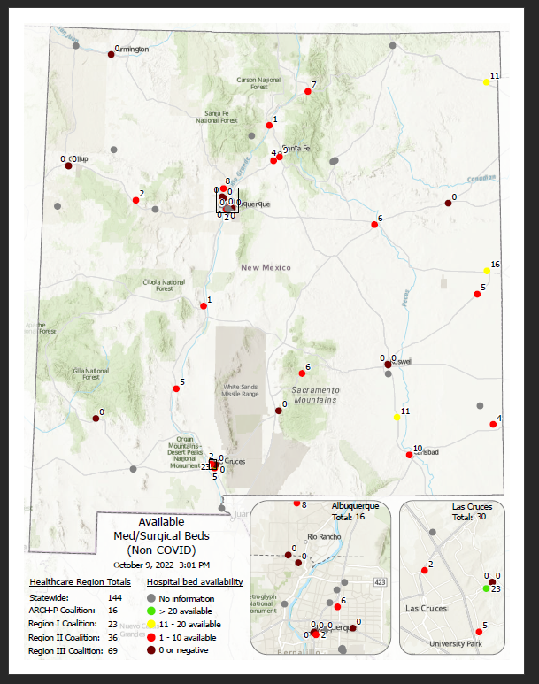
Deliverable (2/3)
PDF Maps (4 daily)
ICU
ICU (COVID-19)
Med/Surg
Med/Surg (COVID-19)

Slide 6
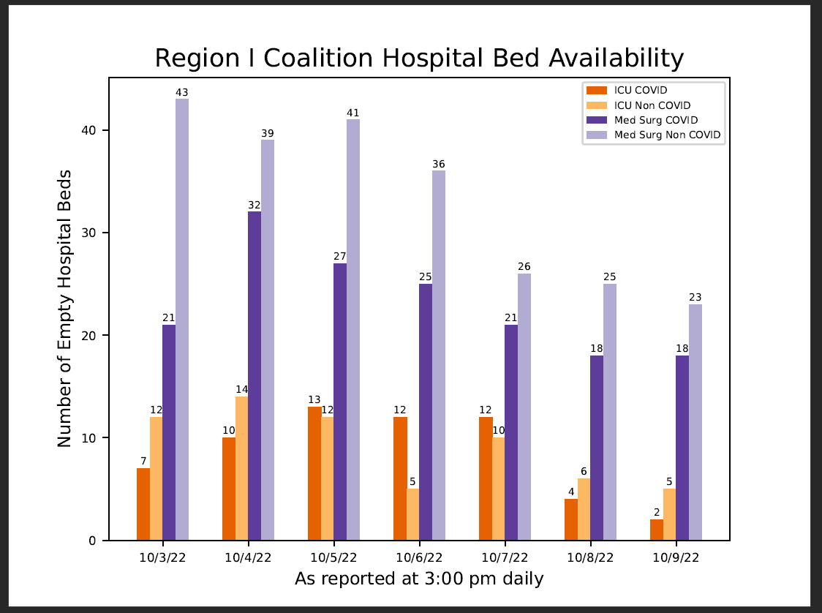
Deliverable (3/3)
Hospital Region Graphs (5 daily)
ARCH-P Coalition
Region I
Region II
Region III
Statewide

Slide 7

How we Accomplished our Objectives

Slide 8

Step 1: Obtain Data Stream
Emergency & Operations Management
Healthcare Resource Management
People & Patient Tracker

Slide 9
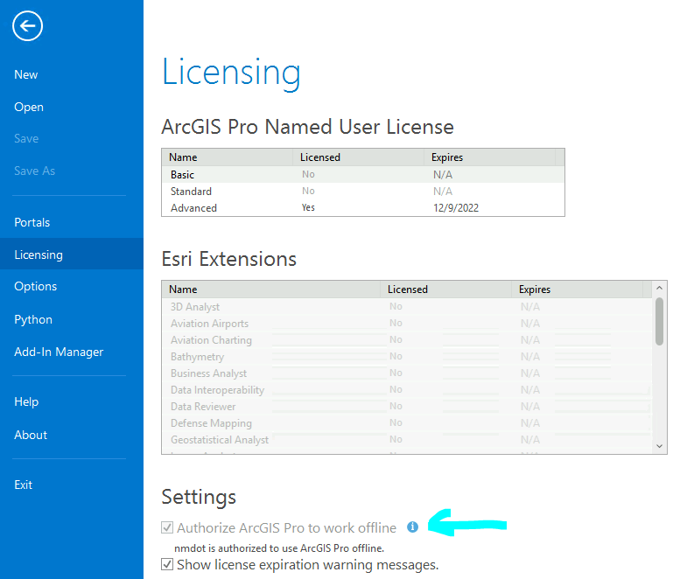
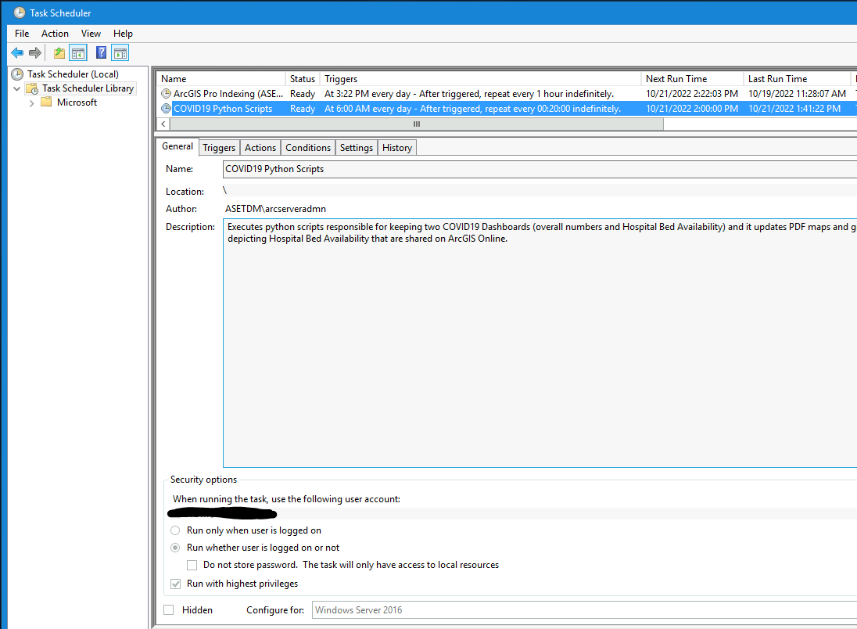
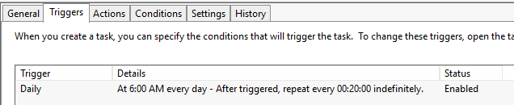
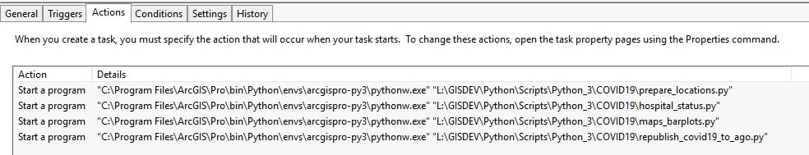
Scheduled Tasks & Pro offline

Slide 10
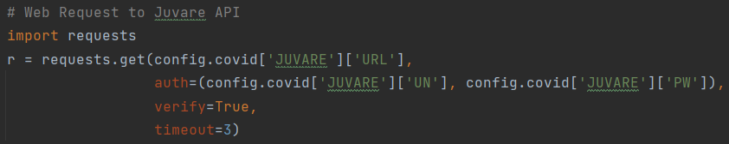
Back-end / Server-side Development
Accessing Juvare REST API
Use Python requests module
HTTP Get request
Authentication

Slide 11
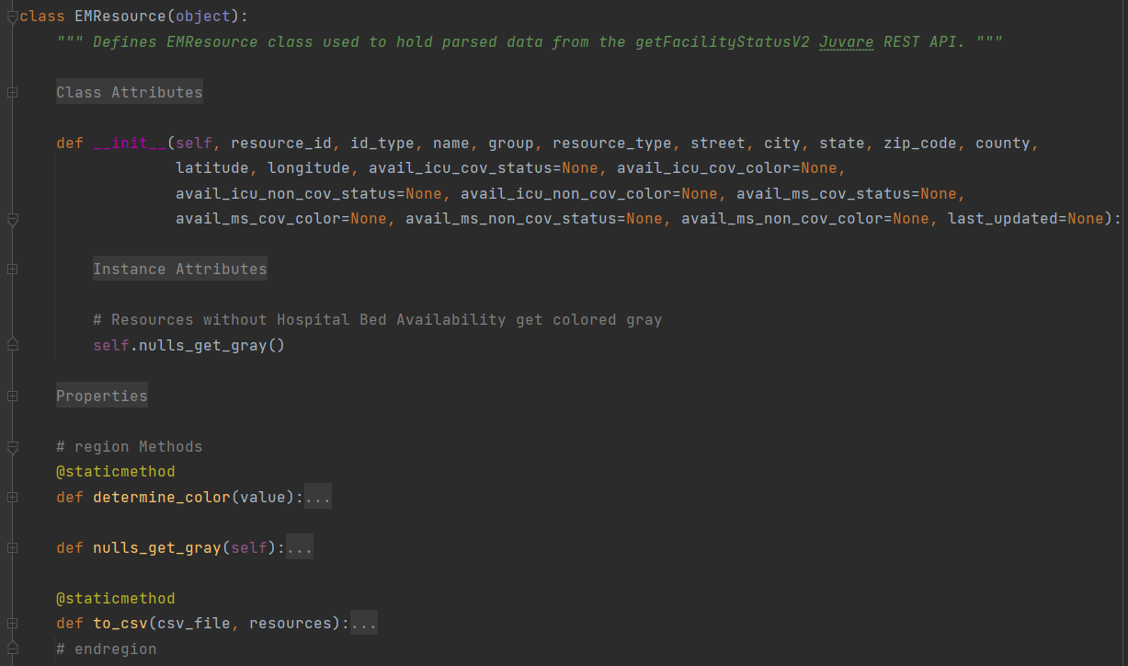
Back-end / Server-side Development
Data class to store an Emergency Response object

Slide 12
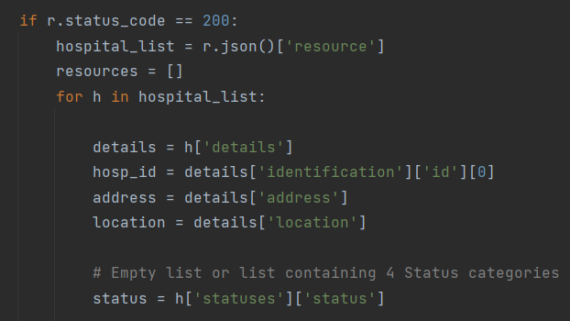
Back-end / Server-side Development
Notes:
r.json() converts the response object’s response from json to a python dictionary

Slide 13
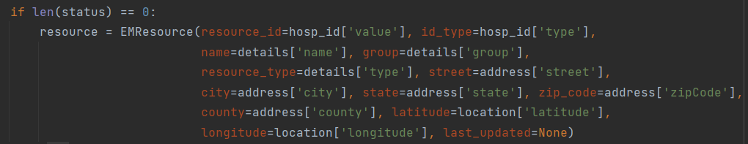
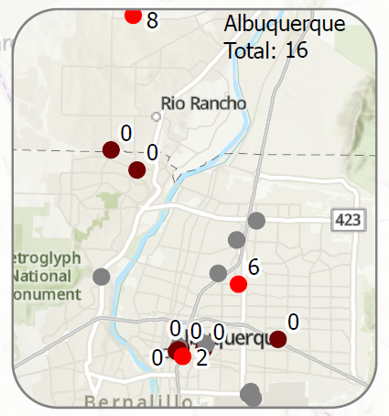
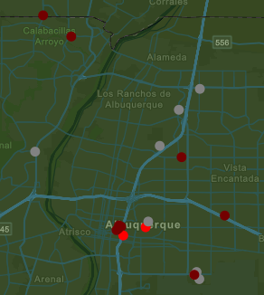
Back-end / Server-side Development
Facilities with no information get symbolized as gray
PDF
Dashboard

Slide 14
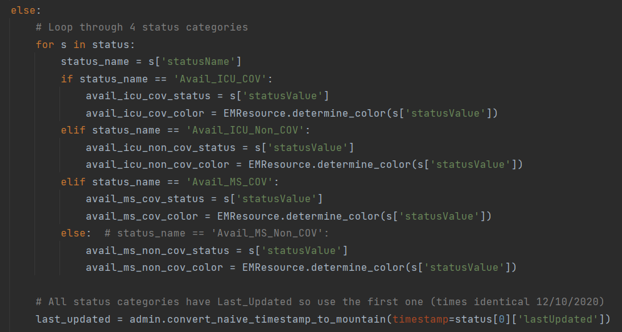
Back-end / Server-side Development

Slide 15
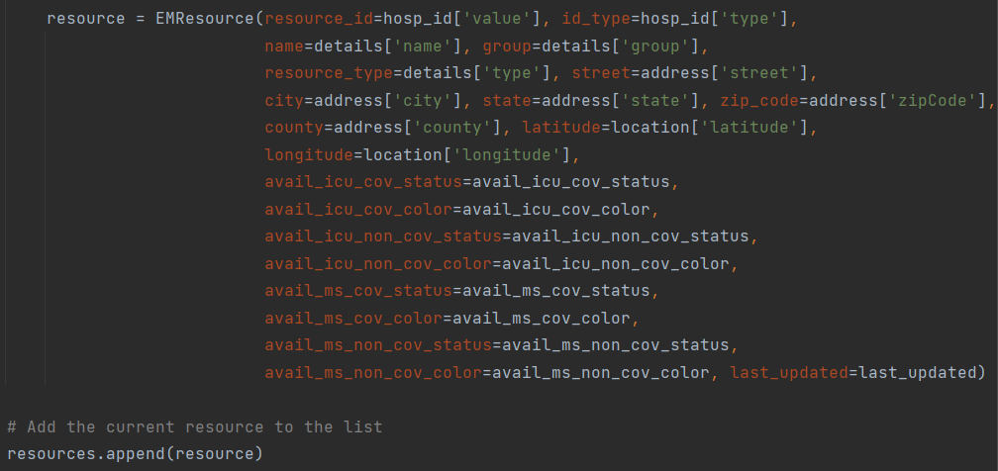
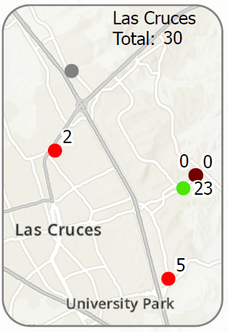
Back-end / Server-side Development
Facilities with information (status value determines exact color used)

Slide 16
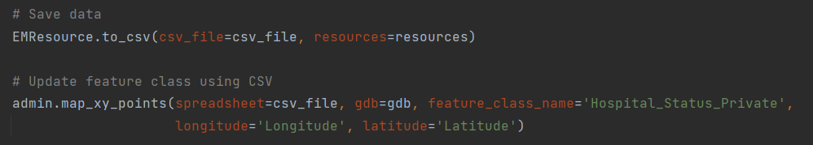
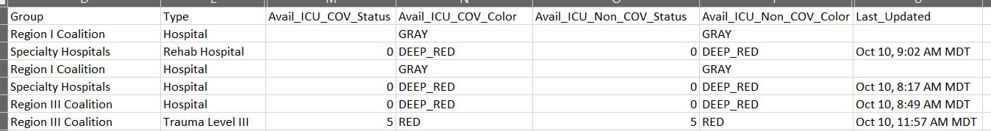
Back-end / Server-side Development
map_xy_points() uses Esri’s arcpy package

Slide 17
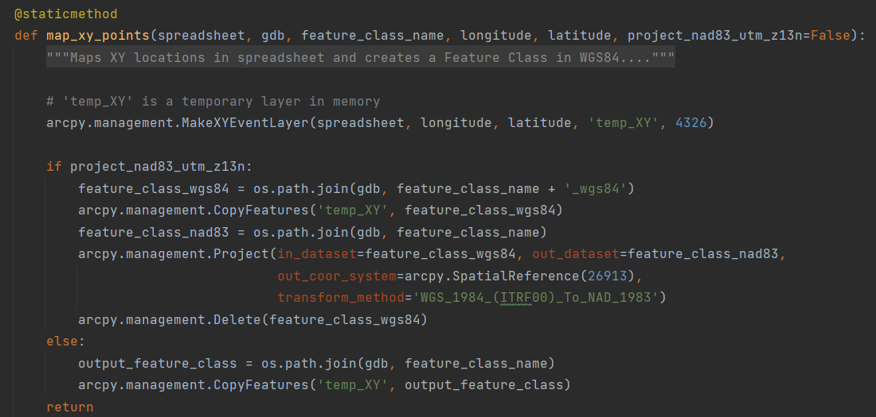
Back-end / Server-side Development
Point feature class is overwritten every time map_xy_points is called

Slide 18
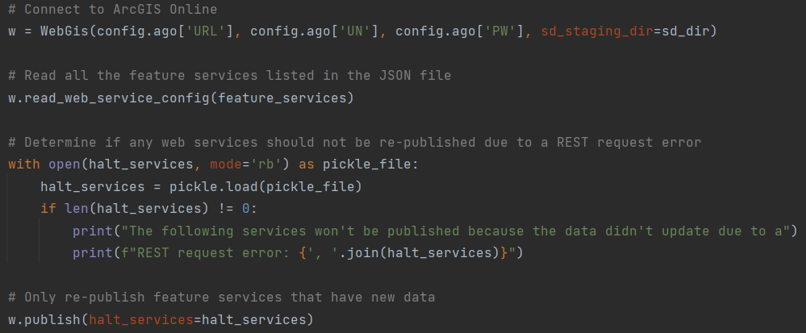
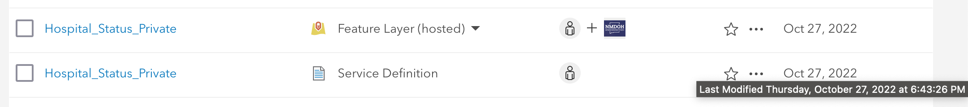
Back-end / Server-side Development
Update Feature Service
ArcGIS API for Python and arcpy
Notes:
Stage Service – looks at data in ArcGIS Pro project obtaining the latest
Creates service definition draft file (.sddraft)
Create service definition
Search for existing service definition file on AGO (search by Title, owner and type=‘Service Definition’) and obtain a reference to it
Call update method on the item (passing fullpath to the new service definition file)

Slide 19
Front-end Development
Deliverable 1/3

Slide 20
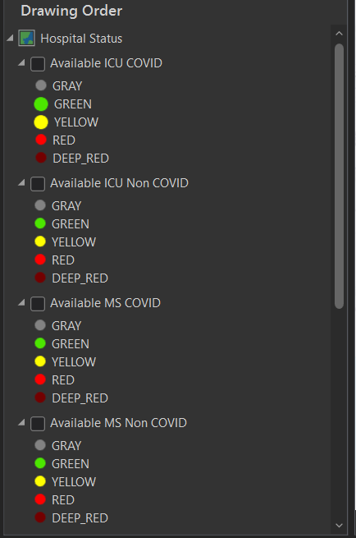
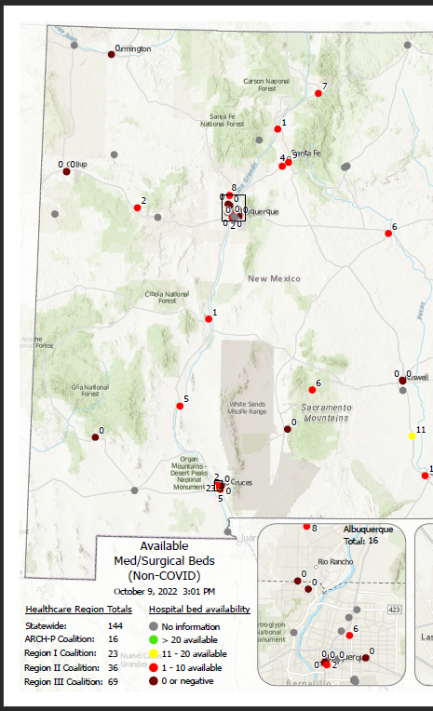
Back-end / Server-side Development
Update 4 PDF maps
ICU
ICU (COVID-19)
Med/Surgical
Med/Surgical (COVID-19)
Deliverable 2/3

Slide 21
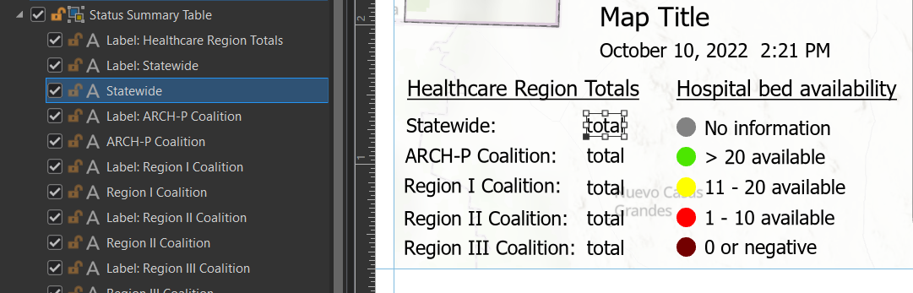
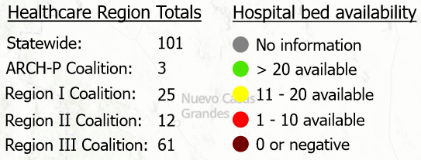
Back-end / Server-side Development

Slide 22
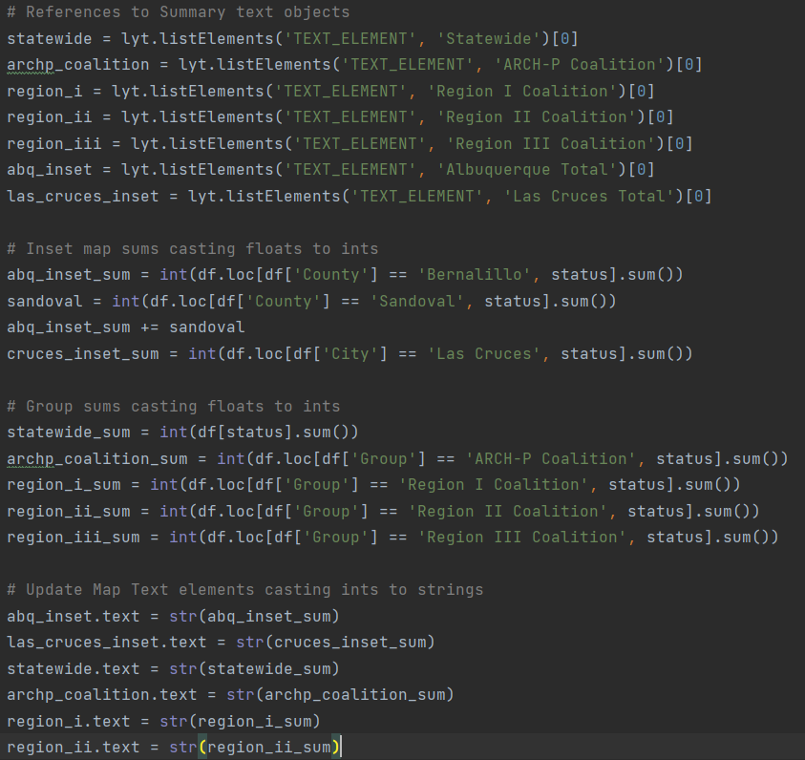
Back-end / Server-side Development

Slide 23
Back-end / Server-side Development
Graphs (5 daily)
ARCH-P Coalition
Region I
Region II
Region III
Statewide
Deliverable 3/3

Slide 24
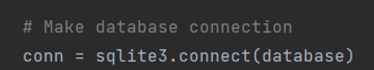
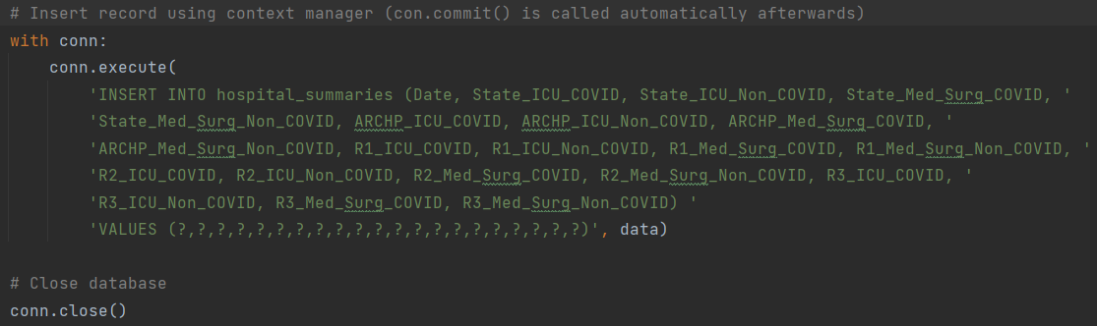

Back-end / Server-side Development
…almost 2 years later and the SQLite3 DB is 128 KB

Slide 25
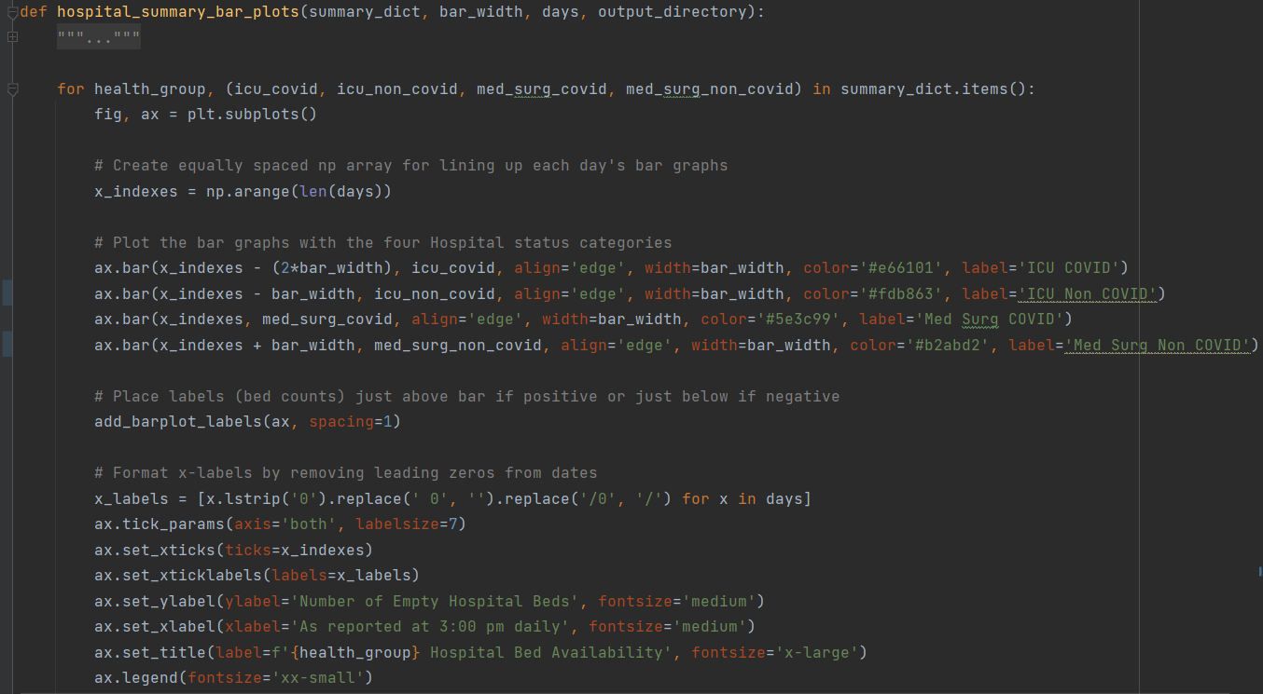
Back-end / Server-side Development

Slide 26
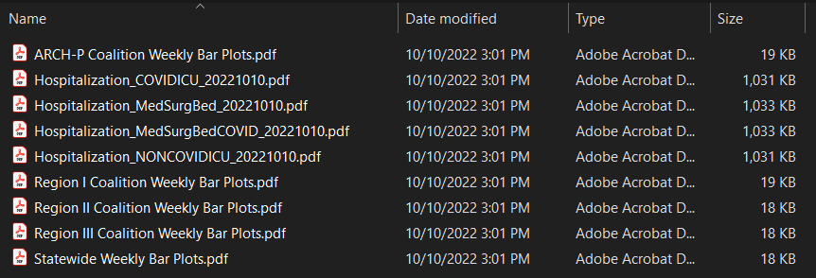
Back-end / Server-side Development
4 maps & 5 graphs created at 3:00 PM every day

Slide 27
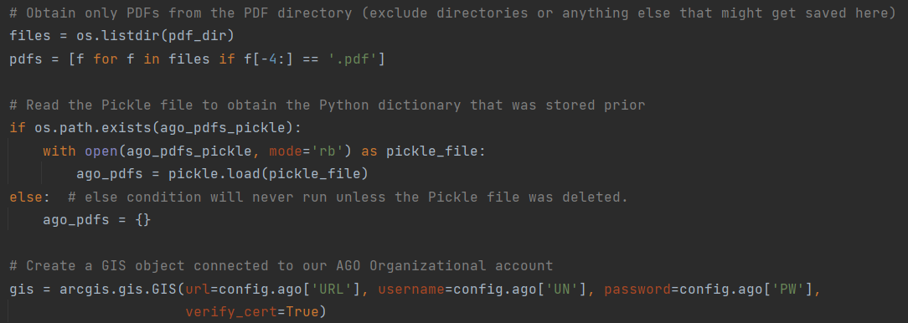
Back-end / Server-side Development
Notes:
Add PDFs to ArcGIS Online daily
Needs to overwrite existing item
Requires storing Item ID
ArcGIS Online security - shared to a group
DOT Admin / DOH

Slide 28
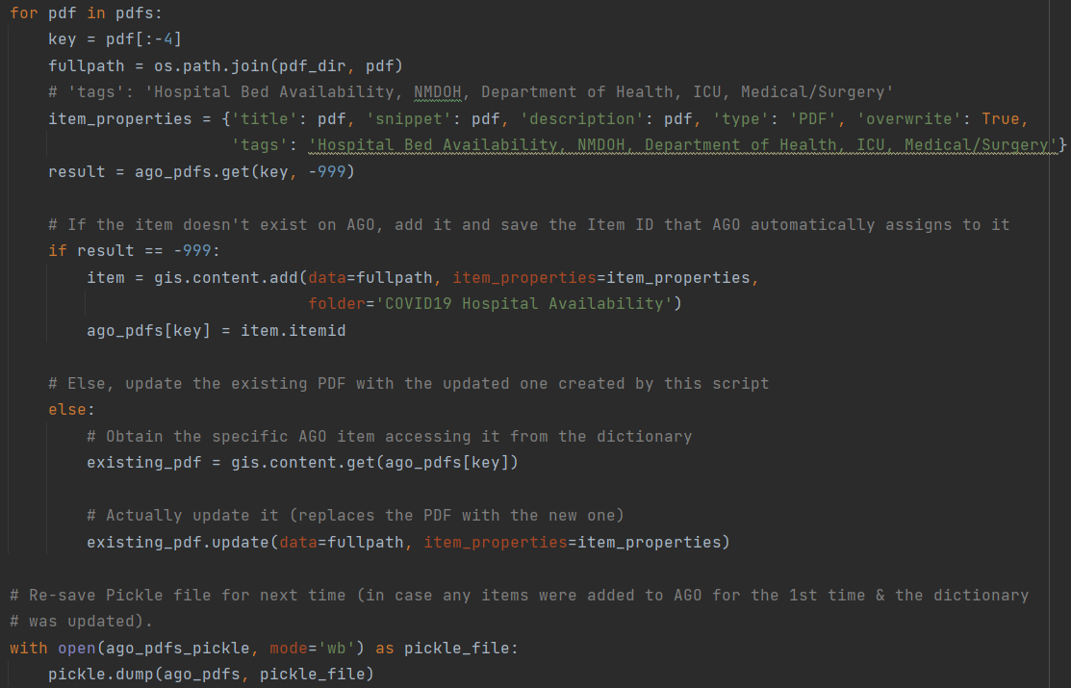
Back-end / Server-side Development

Slide 29
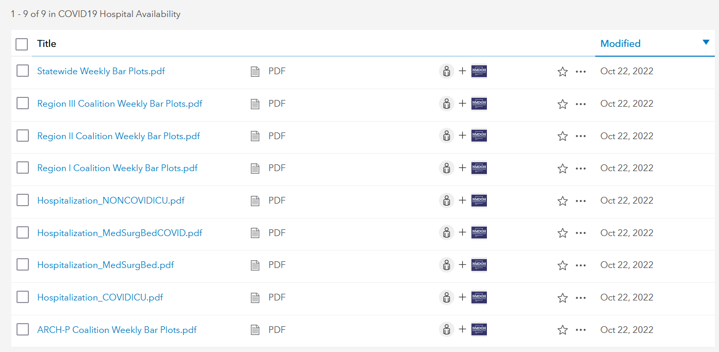
ArcGIS Online
Deliverables 2 & 3

Slide 30
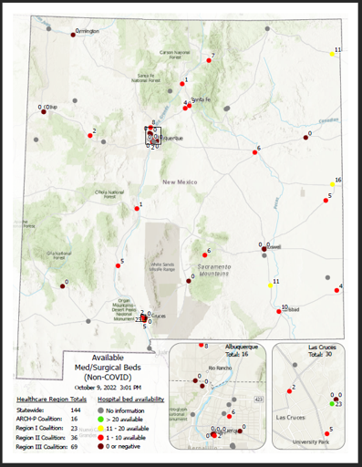
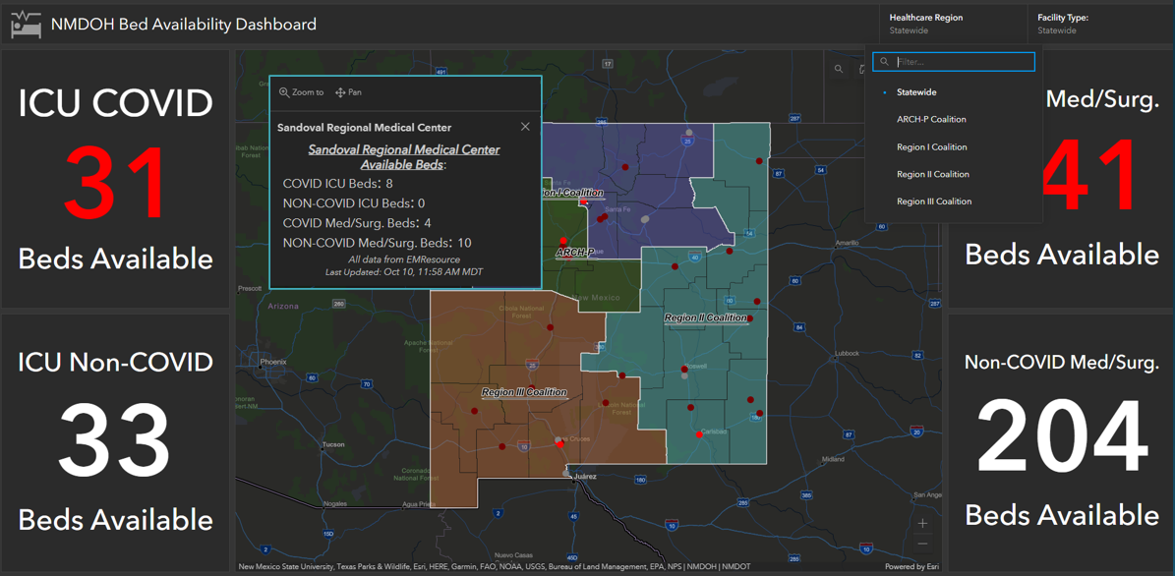

Any Questions?
PowerPoint available: https://github.com/econrad-SF/hospital-availability.git

Slide 31
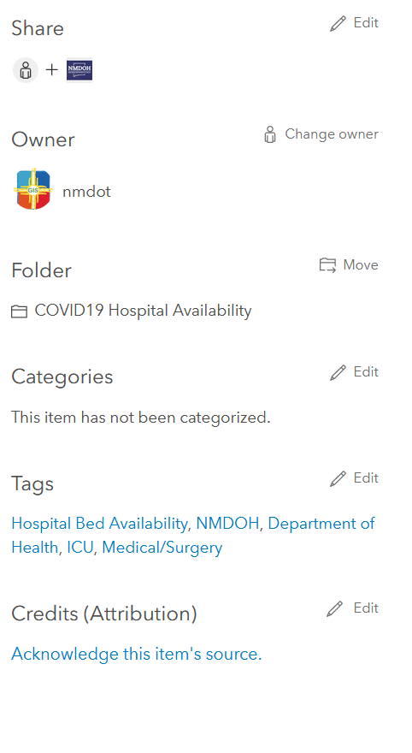
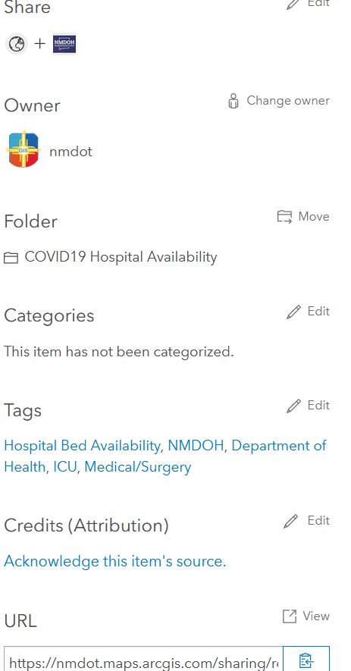
Embed Content in Dashboard?
Sharing = Owner / Organization
Sharing = Public

Slide 32
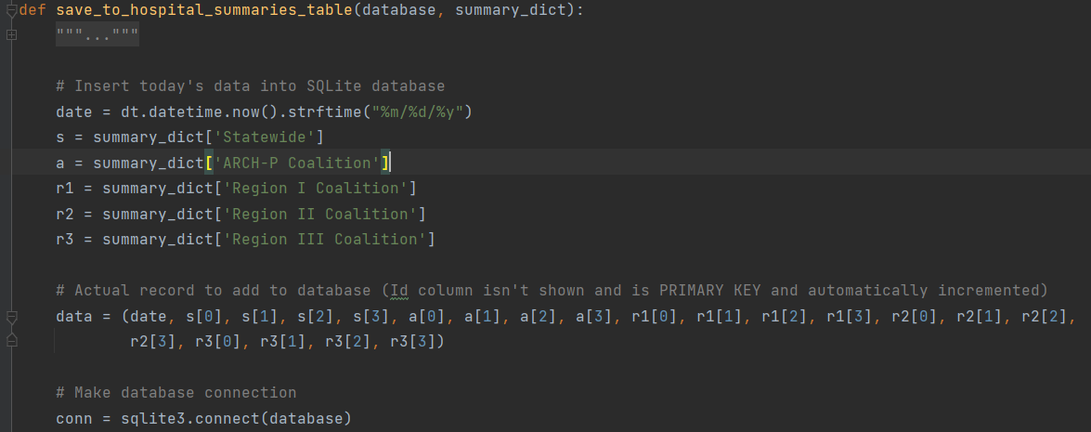

Back-end / Server-side Development
4 values saved by region: ICU, ICU COVID-19, Med/Surg, Med/Surg COVID-19

Slide 33
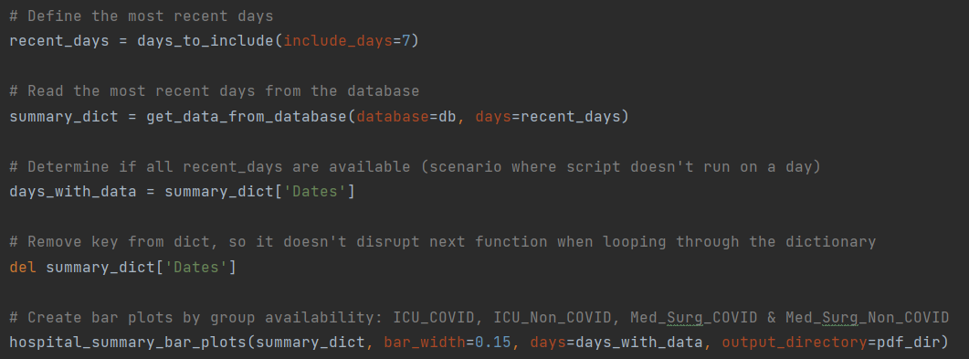
Back-end / Server-side Development
Uses pyplot module in the matplotlib package

